Slide 1
Security Lunch and Learn 3
Nancy Snoke
October 19, 2015

Slide 2
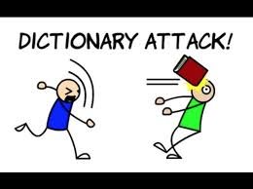
Warmup

Slide 3

Fixing Authentication

Slide 4
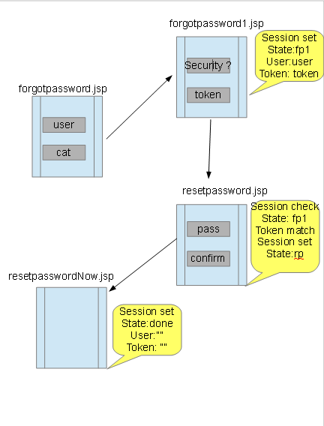
Fixing Authentication

Slide 5
SecureRandom for Tokens
<%@ page import ="java.security.*" %>
SecureRandom random = new SecureRandom();
Integer randInt = random.nextInt(max);

Slide 6
What’s Wrong with Random
Deterministic output based on time
So the token generated with Random can be guessed
http://docs.oracle.com/javase/7/docs/api/java/util/Random.html
Instances of java.util.Random are not cryptographically secure. Consider instead using SecureRandom to get a cryptographically secure pseudo-random number generator for use by security-sensitive applications.

Slide 7
Fixing Hashed Password
CAS
Update password encoder
<bean id="passwordEncoder" class="org.jasig.cas.authentication.handler.DefaultPasswordEncoder" c:encodingAlgorithm="SHA-256" p:characterEncoding="UTF-8" />
Use any encoding algorithm in
java.security.MessageDigest;

Slide 8
Fixing Hashed Password
Application
Make the registration hash the password before storing with
import org.jasig.cas.authentication.handler.DefaultPasswordEncoder;
DefaultPasswordEncoder encoder = new DefaultPasswordEncoder("SHA-256");
String result = encoder.encode(pass);

Slide 9
Other Authentication
Left fixing security questions as an exercise

Slide 10
New Features

Slide 11
2013-A3 – Cross-Site Scripting (XSS)
Occurs any time…
Raw data from attacker is sent to an innocent user’s browser
Raw data…
Stored in database
Reflected from web input (form field, hidden field, URL, etc…)
Sent directly into rich JavaScript client
Virtually every web application has this problem
Try this in your browser – javascript:alert(document.cookie)
Typical Impact
Steal user’s session, steal sensitive data, rewrite web page, redirect user to phishing or malware site
Most Severe: Install XSS proxy which allows attacker to observe and direct all user’s behavior on vulnerable site and force user to other sites

Slide 12
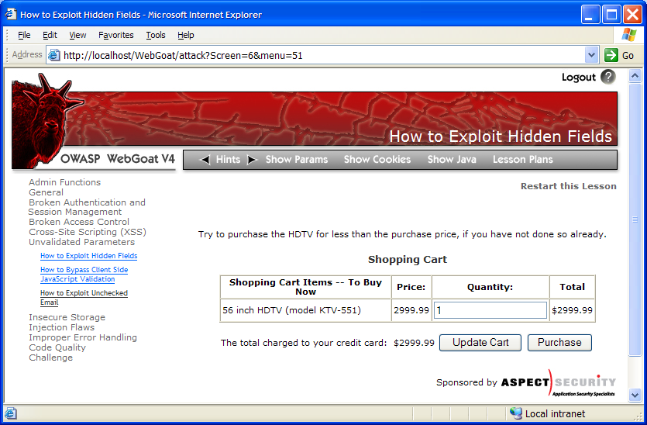


Cross-Site Scripting Illustrated
1
Attacker sets the trap – update my profile
Application with stored XSS vulnerability
Attacker enters a malicious script into a web page that stores the data on the server
2
Victim views page – sees attacker profile
Finance
Transactions
Accounts
Administration
Communication
Knowledge Mgmt
E-Commerce
Bus. Functions
Custom Code
Script runs inside victim’s browser with full access to the DOM and cookies
3
Script silently sends attacker Victim’s session cookie

Slide 13
Basic XSS Demo

Slide 14
XSS Gain Privleges

Slide 15
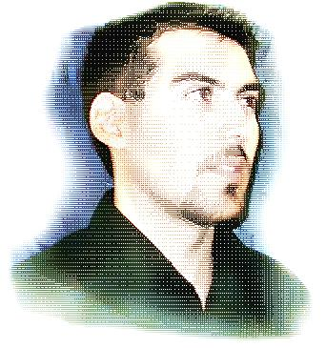
Avoiding XSS Flaws
Recommendations
Eliminate Flaw
Don’t include user supplied input in the output page
Defend Against the Flaw
Use Content Security Policy (CSP)
Primary Recommendation: Output encode all user supplied input (Use OWASP’s ESAPI or Java Encoders to output encode)
https://www.owasp.org/index.php/ESAPI
https://www.owasp.org/index.php/OWASP_Java_Encoder_Project
Perform ‘white list’ input validation on all user input to be included in page
For large chunks of user supplied HTML, use OWASP’s AntiSamy to sanitize this HTML to make it safe
See: https://www.owasp.org/index.php/AntiSamy
References
For how to output encode properly, read the https://www.owasp.org/index.php/XSS_(Cross Site Scripting) Prevention Cheat Sheet
(AntiSamy)

Slide 16
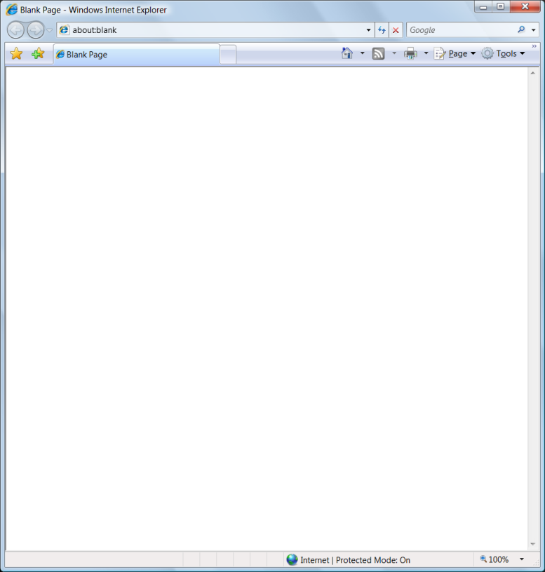
Safe Escaping Schemes in Various HTML Execution Contexts
#1: ( &, <, >, " ) → &entity; ( ', / ) → &#xHH;
ESAPI: encodeForHTML()
HTML Element Content
(e.g., <div> some text to display </div> )
#2: All non-alphanumeric < 256 → &#xHH;
ESAPI: encodeForHTMLAttribute()
HTML Attribute Values
(e.g., <input name='person' type='TEXT' value='defaultValue'> )
#3: All non-alphanumeric < 256 → \xHH
ESAPI: encodeForJavaScript()
JavaScript Data
(e.g., <script> someFunction(‘DATA’)</script> )
#4: All non-alphanumeric < 256 → \HH
ESAPI: encodeForCSS()
CSS Property Values
(e.g., .pdiv a:hover {color: red; text-decoration: underline} )
#5: All non-alphanumeric < 256 → %HH
ESAPI: encodeForURL()
URI Attribute Values
(e.g., <a href=" http://site.com?search=DATA" )
ALL other contexts CANNOT include Untrusted Data
Recommendation: Only allow #1 and #2 and disallow all others
See: www.owasp.org/index.php/XSS_(Cross_Site_Scripting)_Prevention_Cheat_Sheet

Slide 17
Fixing XSS

Slide 18
Fixing XSS
Using OWASP Esapi
Update POM
<dependency>
<groupId>org.owasp.esapi</groupId>
<artifactId>esapi</artifactId>
<version>2.1.0</version>
</dependency>

Slide 19
Fixing XSS -- continued
In the application
<%@ page import="org.owasp.esapi.ESAPI" %>
<%=ESAPI.encoder().encodeForHTML(printComment)%>

Slide 20
Fixing XSS
ESAPI
Must have an ESAPI.properties file
Location is by default outside of wepapp
C:\Users\Me\esapi\ESAPI.properties
https://owasp-esapi-java.googlecode.com/svn/trunk/configuration/esapi/ESAPI.properties

Slide 21
Whitelisting: What type of white list could be used for cat’s name?

Slide 22
https://google-gruyere.appspot.com/

Slide 23
Links
https://www.youtube.com/watch?v=WifMAzjg-uY&list=PLN4xLdCXjOvTS0jXafcllAkYZy9IurxQ4
https://github.com/securitymagick/CAS-tutorials

